Slide 2
1 in 10 people in the world have
the superpower dyslexia.

Slide 3
Brain scans have shown that people with dyslexia think in a different way and this leads to skills such as:
creativity
imagination
being
inventive
storytelling
connecting ideas
being able to see the bigger picture
problem-solving
compassion
thinking in 3D

Slide 4
People without dyslexia think in straight lines.
Dyslexic thinking is like a pinball machine because ideas bounce around your brain until they hit the jackpot!

Slide 5
This kind of thinking has led to some amazing people with dyslexia doing some incredible things.

Slide 6
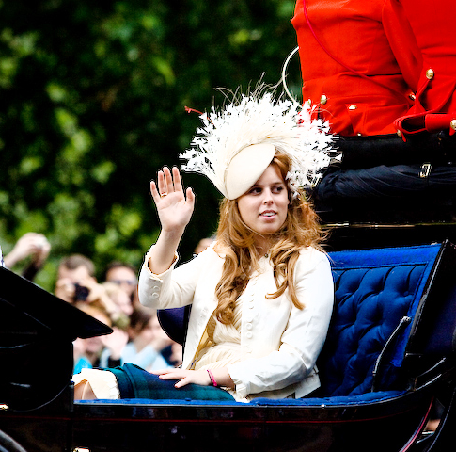
HRH Princess Beatrice
HRH Princess Beatrice is the fifth grandchild of Queen Elizabeth II and Prince Philip, Duke of Edinburgh.
She was identified as having dyslexia at the age of seven and received specialist help.
Her Royal Highness went on to pass eight GCSEs, three A levels and graduated with a 2:1 in History and the History of Ideas from Goldsmiths College, London.
In 2016, she said: “When you go into a workplace, your ability to think differently allows you to be more creative. It allows you to approach problems slightly differently and it allows you to be a little bit more flexible.”
“HRH Princess Beatrice of York” by Vee de Rodgers is licensed under CC BY 2.0

Slide 7
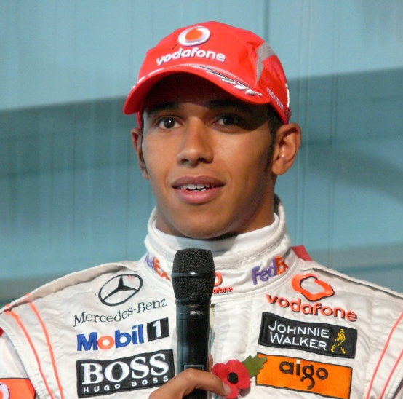
Lewis Hamilton
Lewis Hamilton is a British racing driver who races in Formula One for the Mercedes-AMG Petronas Formula One Team.
He is a six-time Formula One World Champion. He is widely regarded as one of the greatest drivers in the history of the sport.
He found out he had dyslexia when he was 17 years old.
He said that dyslexia taught him to never give up and that failures were a necessary part to success.
“Lewis Hamilton” by Alistair Rickman is licensed under CC BY 2.0

Slide 8
Holly Willoughby
Holly Willoughby is an English television presenter, model and author.
She is currently the co-presenter of
This Morning and Dancing on Ice.
Through her role as a television presenter, she has to read the Autocue but, by using some strategies, she doesn’t let her dyslexia stop her.
“Holly-Willoughby-instagram-outfit-934316” by ALAIN BONGLET is licensed under Public Domain

Slide 9
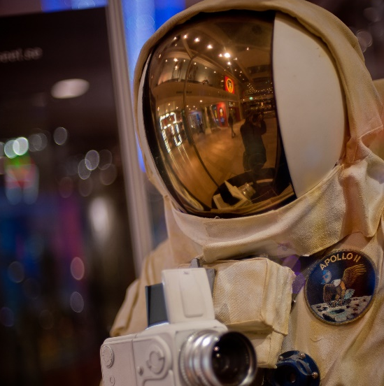
NASA
NASA (North American Space Administration) reports that over 50% of NASA employees are reported as dyslexic.
They are said to be deliberately sought after because they have superb problem-solving skills and excellent 3D and spatial awareness.
“NASA Spacesuit” by Possan is licensed under CC BY 2.0

